Slide 1


Ford Commercial Business Solutions

Slide 2
Ford Commercial Business Solutions
Navigation – Click on this tab to go
to any module within the course.
Module Title – The top of the screen display the name of the module.
Resource – Click this icon to
view and print the Job Aid for this
Course.
Leave Anytime – Clicking the “Exit” button closes the module. Your progress is automatically saved so that the next time you log in, you can begin from where you left off.
Help – Brings up these navigation
Tips.
Back/Next – Click to move backward or forward one page.
Progress Indicator – Displays your progress
through the current module.

Slide 3
Ford Commercial Business Solutions
JOB AID PDF COVER (still being designed)

Slide 4
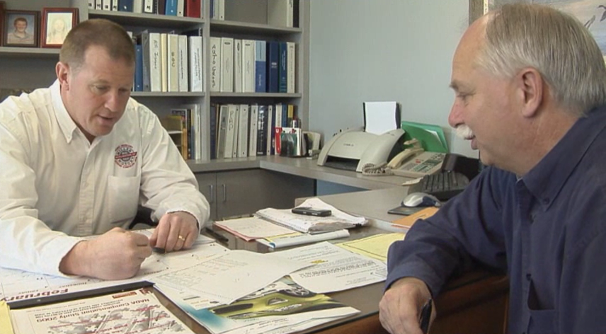
Are You Losing Commercial Business to Competitors Like This?
Before we finalize the vehicle order for your business, Ted, I’d like to tell you how we can help you manage your expenses throughout your ownership cycle.
Well, I do manage my own vehicle expenses. I’m not sure what you can do for me.
Fleet Management Company Representative
Commercial Customer

Slide 5
Are You Losing Commercial Business to Competitors Like This?
What we offer is a way you can do that more efficiently and conveniently … and save money. Are you interested in learning more?
Now, you’ve got my attention. Go on.
Fleet Management Company Representative
Commercial Customer

Slide 6
Are You Losing Commercial Business to Competitors Like This?
Our fleet service management plan offers you a full maintenance program with a fixed cost for all routine maintenance and repairs, hundreds of service locations across the country, monthly reporting and billing, and more.
That sounds like something I would be interested in – especially if it saves me time and money. Tell me more.
Fleet Management Company Representative
Commercial Customer

Slide 7

Are You Losing Commercial Business to Competitors Like This?
They go beyond selling or leasing
They provide products and services to help customers manage their vehicles more efficiently and cost effectively

Slide 8
Are You Losing Commercial Business to Competitors Like This?
Other OEMs and companies with fleet management services have professional presentations

Slide 9
STOP Losing Commercial Business to these
Competitors!

Slide 10
Course Objectives
Recognize the value of a holistic selling approach
Explain the opportunity of Ford Commercial Business Solutions for increasing dealership commercial business and profitability
Identify customer needs and wants for commercial vehicle services
Demonstrate the benefits and value of Ford Commercial Business Solutions over the competition
Develop customized presentations within a consultative sales process to sell Ford Commercial Business Solutions

Slide 11

Course Agenda
Agenda
Module 1: The Opportunity
Module 2: What is Ford Commercial Business Solutions?
Module 3: Selling Strategies
Module 4: Resources and Tools
Wiegand’s
Wisdom

Slide 12
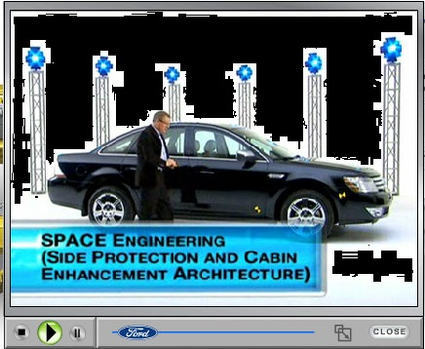
Course Agenda
Wiegand’s
Wisdom

Slide 13
Module 1:
The Opportunity

Slide 14
The Commercial Market and Ford
Commercial Vehicle Sales Trend
Sales
One out of every 5 vehicles sold in the U.S. becomes a fleet vehicle!
Years
Commercial vehicle sales projected to continue growing
Sources: Automotive Fleet Magazine/Bobit Business News

Slide 15

The Commercial Market and Ford
Commercial Vehicle Sales Trend
Sales
250,000+ in U.S. fleet sales
Ford vehicles comprise nearly half of all fleets
30% Ford U.S. Sales to fleet
Years
Commercial vehicle sales projected to continue growing
Sources: Automotive Fleet Magazine/Bobit Business News

Slide 16

The Commercial Market and Ford
Commercial Vehicle Sales Trend
Sales
250,000+ in U.S. fleet sales
Ford vehicles comprise nearly half of all fleets
30% Ford U.S. Sales to fleet
Competitors manage
700,000 Ford VINs
Years
Commercial vehicle sales projected to continue growing
Wiegand’s
Wisdom
Sources: Automotive Fleet Magazine/Bobit Business News

Slide 17
The Commercial Market and Ford
Wiegand’s
Wisdom

Slide 18
Module 2:
What Is Ford Commercial Business Solutions?

Slide 19
What is Ford Commercial Business Solutions?
A ONE Ford strategy that provides commercial customers a comprehensive, customized, total transportation solution
Supports one-stop shopping
Reduces life cycle costs
Improves operational efficiencies
Eliminates service variability

Slide 20





What is Ford Commercial Business Solutions?
For this page and following, we need a version with and without the Commercial Services PLUS logo
Ford Commercial Business Solution
Notes:
Add the PremiumCare and Premium Maintenance Logos near the ESP logo
DELETE the CSP logo
ISSUE: CSP logo will need to return if the clients approve the alternate read that includes CSP.

Slide 21

Why ESP?
Advantages:
Money-saving solutions with zero-deductible
Customizable to help control costs and reduce operating expenses
Ford/Lincoln/Quick Lane national network of factory-trained technicians using genuine OE parts ensure quality repairs
Roadside Assistance with destination assistance and travel reimbursement
Wear and tear covered

Slide 22
Why QFC?
www.qfc.ford.com
Advantages:
Cardless/cashless solution for fleet drivers
Monthly billing for all services performed at Ford and Lincoln dealers and Quick Lane Tire and Auto Centers (U.S. and Canada)
National Glass Program
Enhanced Roadside Assistance
Electronic billing via CD, FTP or QFC
Online services available through QFC
Coverage displayed on OASIS including fleet account contact information
Non-Ford vehicle eligibility
Quality Fleet Care Parts Program (QFCP)

Slide 23
YOU Have the Strongest
Solution in the Marketplace!
Competitors’ Weaknesses:
Terms don’t meet usage requirements
Repairs delayed to negotiate cost of service
May not ensure maintenance/ repairs are performed by factory-trained technicians using genuine OE parts
Have wear and tear exclusions
Have warranty limitations
Competitors’ Weaknesses:
May have maintenance limitations
May have limitations on non-covered purchases/services
May not cover mixed fleets
May not offer spending controls
May not offer online fleet service management

Slide 24
Why CSP?
This slide will probably be deleted (along with all of the “Alternate Reads”)
CSP is a comprehensive fleet management program available
exclusively on Ford Credit financed or leased vehicles.
Service, maintenance, administration, management
Fuel card
Automatic license renewal
Accident management
Subrogation services

Slide 25
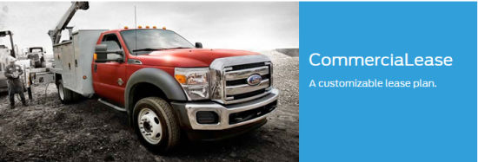

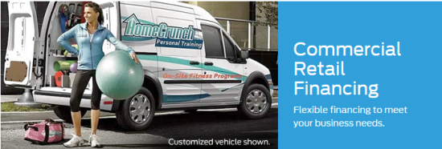
Ford Credit Financing Completes the Solution
Click on each image to learn more.

Slide 26
Ford Credit Financing Completes the Solution
Click on each image to learn more.
Can be tailored to meet unique business needs
Improves cash flow
No mileage restrictions
No wear and use lease-end charges

Slide 27
Ford Credit Financing Completes the Solution
Click on each image to learn more.
Can be tailored to meet unique business needs
Improves cash flow
No mileage restrictions
No wear and use lease-end charges
Availability of credit when needed to cover all eligible vehicle financing needs
No enrollment or maintenance fees
Frees up capital

Slide 28
Ford Credit Financing Completes the Solution
Click on each image to learn more.
Can be tailored to meet unique business needs
Improves cash flow
No mileage restrictions
No wear and use lease-end charges
Availability of credit when needed to cover all eligible vehicle financing needs
No enrollment or maintenance fees
Frees up capital
Competitive rates
No hidden fees or GVW restrictions

Slide 29
Ford Credit Financing Completes the Solution
Customers can finance 100% of the cost of
the Ford Commercial Business Solution!
Can be tailored to meet unique business needs
Improves cash flow
No mileage restrictions
No wear and use lease-end charges
Availability of credit when needed to cover all eligible vehicle financing needs
No enrollment or maintenance fees
Frees up capital
Competitive rates
No hidden fees or GVW restrictions
Lee’s Lesson

Slide 30
Ford Credit Financing Completes the Solution
Lee’s Lesson

Slide 31

Ford Commercial Business Solutions Competitive Advantages
You:
 | Provide comprehensive transportation solutions with one-stop shopping
 | Are dedicated account managers
 | Can reduce customers’ life cycle costs
 | Can improve customers’ operational efficiencies
 | Have an integrated approach covering sales and service
 | Can reduce service variability and customers’ expenses
 | Can compete!

Slide 32
Knowledge Check ESP/QFC Competitive Comparison
Which of the following are features of Ford Commercial Business Solutions, but MAY NOT be offered by competitive fleet service management companies or they may change extra for them?
Select all that apply.
Covers failure of covered components due to wear and tear
License renewal
Driver profile reporting
Website access/online billing & reports
Repairs performed by factory-trained technicians using OE parts
Exception reports
Spending controls
Cost containment
✓
✓
✓
✓
✓
SUBMIT

Slide 33
Knowledge Check Ford Credit Financing Options
No mileage restrictions
Typically lower payments than traditional financing
Availability of credit to cover all eligible vehicle financing needs
No enrollment or maintenance fees
No hidden fees
No GVW restrictions

Slide 34
Module 3: Selling Ford Commercial Business Solutions

Slide 35
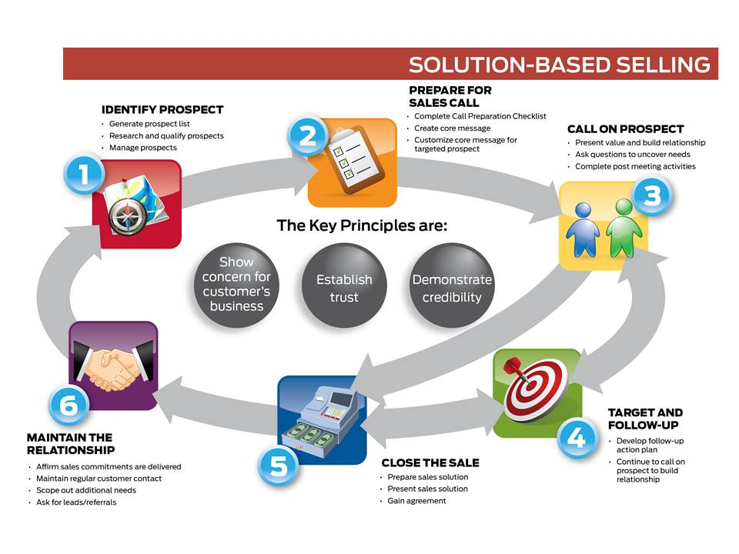
The Sales Approach
Prepare for sales call
Qualify the customer
Present proposal
Close the sale
Maintain the relationship

Slide 36

Step 1: Qualifying the Customer
Insert Step One Icon
See Note in graphics section
CAM Michelle qualifies all of her customers to identify good candidates for Ford Commercial Business Solutions.
Replace with ethnic female, here and throughout

Slide 37
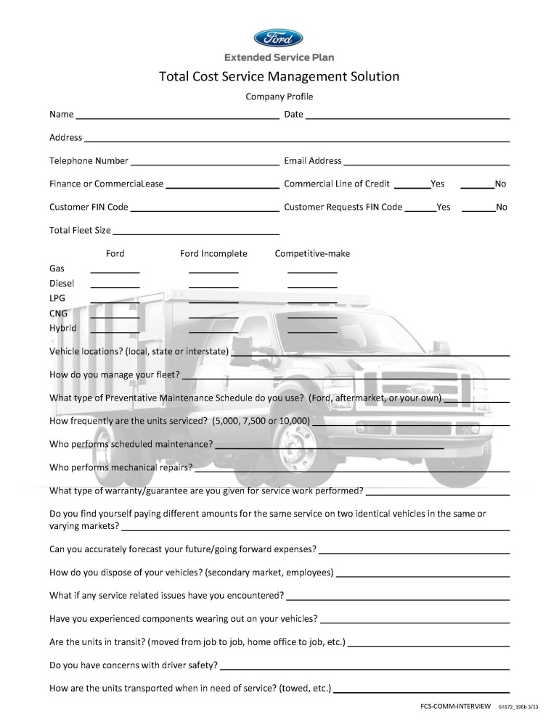
Step 1: Qualifying the Customer Customer Interview Form
You and Michelle can use the Customer Interview form to help identify a customer’s needs and wants. With that information, she can customize a Ford Commercial Business Solution that accurately reflects his customer’s specific circumstances.
Click on each highlighted area for more information on the tool.

Slide 38
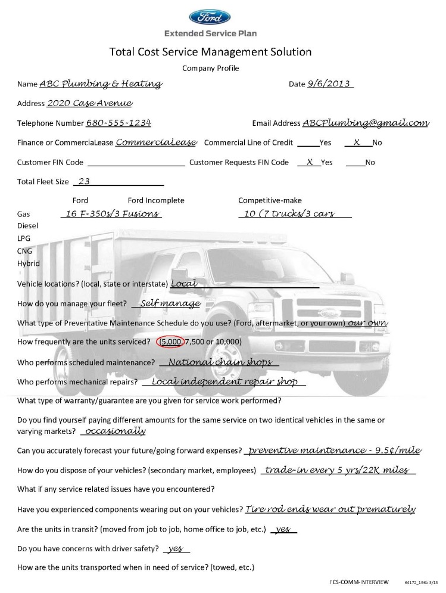
Step 1: Qualifying the Customer Customer Interview Form
Your Commercial Customer:
Fleet Manager of ABC Plumbing & Heating
Employs 20 plumbers and HVAC technicians and 5 salespeople
Fleet of 23 upfitted trucks and 6 leased cars
3 of the leased cars are near lease-end

Slide 39
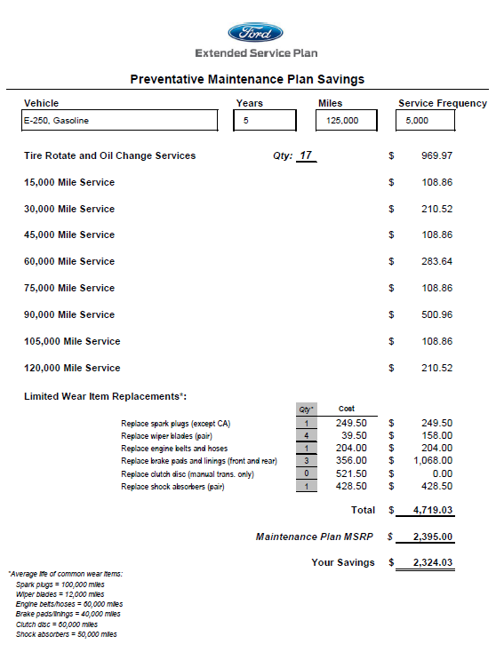
Step 1: Qualifying the Customer Cost-per-Mile Value Builder
You and Michelle have an excellent sales tool in the Commercial Cost-per-mile Value Builder Quick Quote Tool. With it, you can demonstrate the value of adding ESP PremiumCARE and Premium Maintenance to vehicle purchase or lease.
Click on the Wiegand’s Wisdom icon to see how it works.
Wiegand’s
Wisdom

Slide 40
Step 1: Qualifying the Customer Cost-Per-Mile Value Builder
Wiegand’s
Wisdom

Slide 41
The Sales Approach

Slide 42
Step 2: Prepare for the Sales Call
How are you going to address this customer’s needs and wants?
ESP PremiumCARE $0 Deductible
3 years/60,000 miles
4 years/75,000 miles
5 years/100,000 miles
5 years/125,000 miles
ESP Premium Maintenance
3 years/60,000 miles/ 3,000 hours
4 years/75,000 miles/ 3,000 hours
5 years/125,000 miles/5,000 hours
5 years/150,000 miles/6,000 hours
CommerciaLease
Ford Commercial Lines of Credit
QFC
Submit

Slide 43
Step 2: Prepare for the Sales Call
How are you going to address this customer’s wants and needs?
ESP PremiumCARE $0 Deductible
3 years/60,000 miles
4 years/75,000 miles
5 years/100,000 miles
5 years/125,000 miles
ESP Premium Maintenance
3 years/60,000 miles/ 3,000 hours
4 years/75,000 miles/ 3,000 hours
5 years/125,000 miles/5,000 hours
 5 years/150,000 miles/6,000 hours
 CommerciaLease
 Ford Commercial Lines of Credit
 QFC

Slide 44
Step 2: Prepare for the Sales Call
Commercial Cost-Per-Mile Value Builder Quick Quote Tool

Slide 45
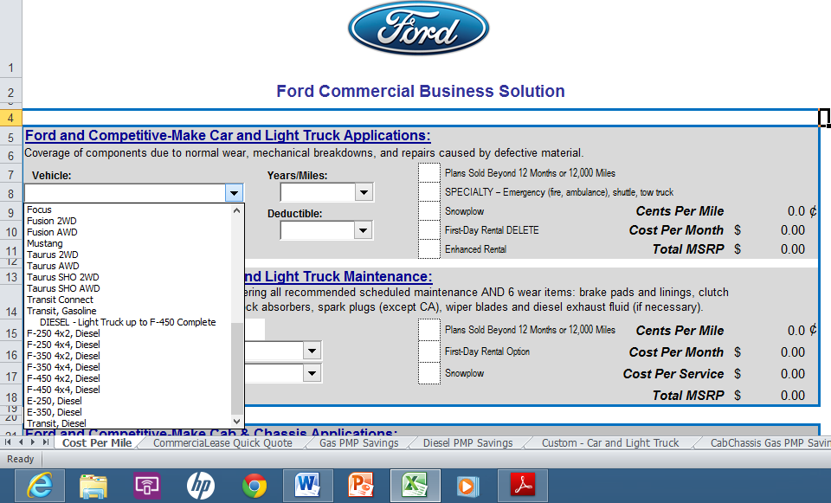
Step 2: Prepare for the Sales Call
Commercial Cost-Per-Mile Value Builder Quick Quote Tool
Ford and Competitive-Make Car and Light Truck Applications section:
In Vehicle field, click on the correct selection from the drop-down menu. When you’ve made the correct choice, click next to advance.
Taurus SHO AWD
Transit Connect
Transit, Gasoline
F-250 4x2 Diesel
F-250 4x4 Diesel

Slide 46
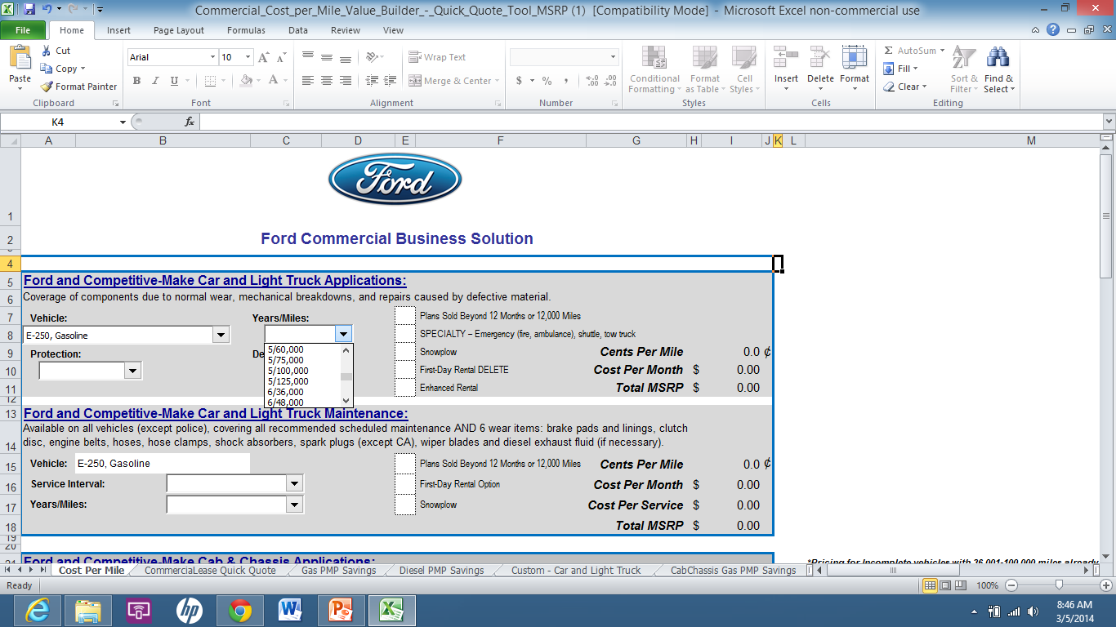
Step 2: Prepare for the Sales Call
Commercial Cost-Per-Mile Value Builder Quick Quote Tool
In Ford and Competitive Make Car and Light Truck Applications section:
In Years/Miles field, click on the correct selection from the drop-down menu. When you’ve made the correct choice, click next to advance.
5/60,000
5/75,000
5/100,000
5/125,000
6/36,000
NOTE that the previous properly selected choice from the drop-down is populated and shown here. This should be the case for all of these grabs. All correct drop-down choices will populate as the user progresses
Transit, Gasoline
Notes:
NOTE that not all of the selections that are on the actual drop-down are listed here as choices – there are too many.

Slide 47
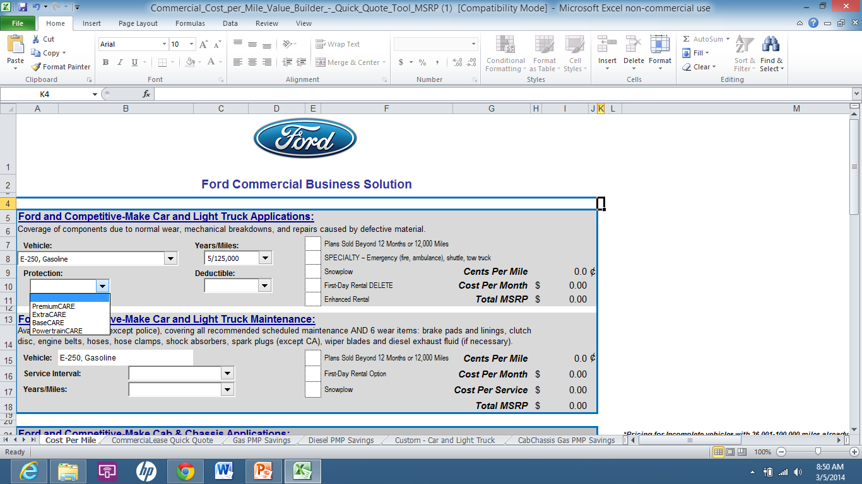
Step 2: Prepare for the Sales Call
Commercial Cost-Per-Mile Value Builder Quick Quote Tool
In Ford and Competitive Make Car and Light Truck Applications section:
In Protection field, click on the correct selection from the drop-down menu. When you’ve made the correct choice, click next to advance.
PremiumCARE
ExtraCARE
BaseCARE
PowertrainCARE
Transit, Gasoline

Slide 48
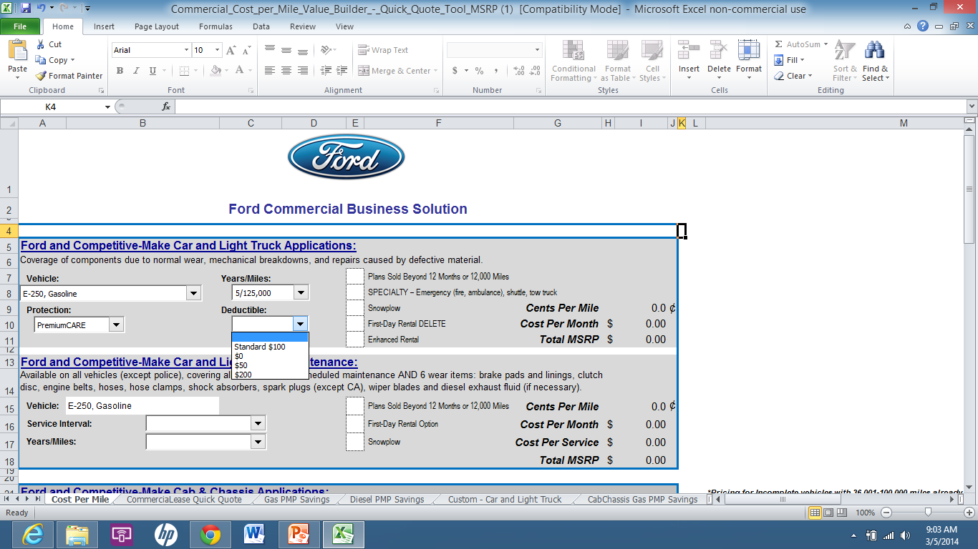
Step 2: Prepare for the Sales Call
Commercial Cost-Per-Mile Value Builder Quick Quote Tool
In Ford and Competitive Make Car and Light Truck Applications section:
In Deductible field, click on the correct selection from the drop-down menu. When you’ve made the correct choice, click next to advance.
Standard $100
$0 Deductible
$200 Deductible
Transit, Gasoline

Slide 49
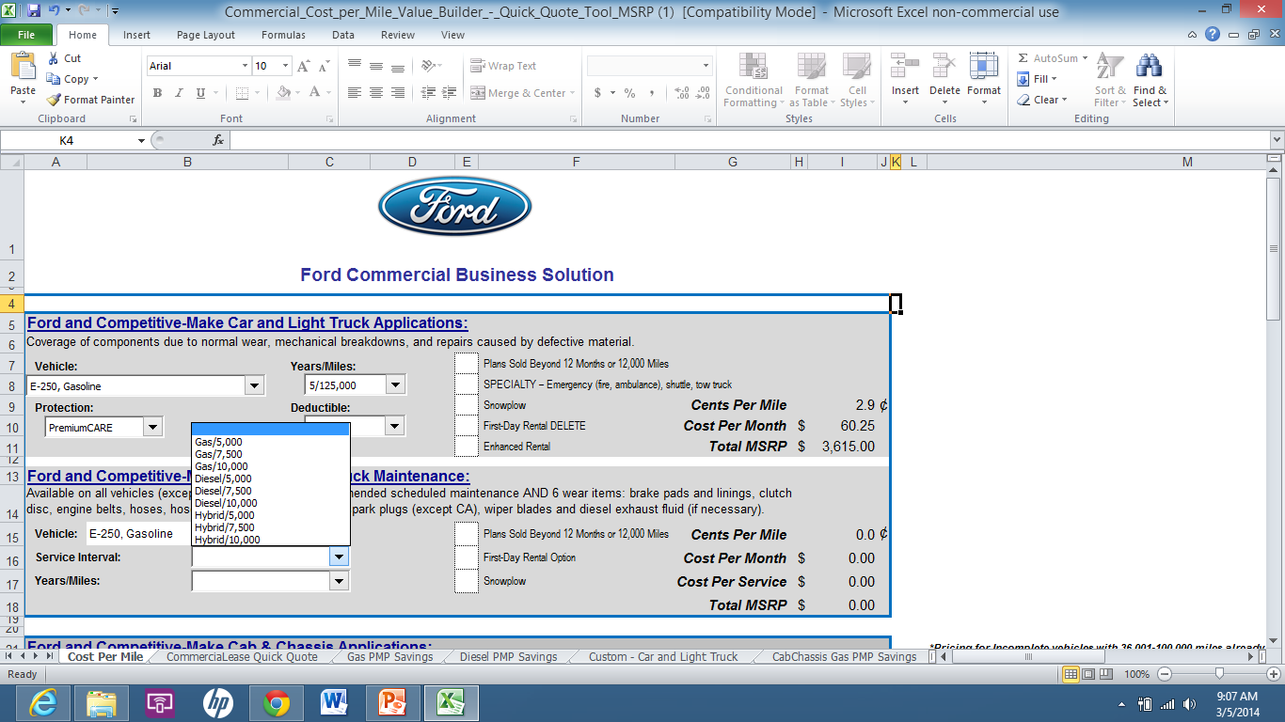
Step 2: Prepare for the Sales Call
Commercial Cost-Per-Mile Value Builder Quick Quote Tool
In Ford and Competitive Make Car and Light Truck Maintenance section:
In Service Interval field, click on the correct selection from the drop-down menu. When you’ve made the correct choice, click next to advance.
Gas/5,000
Gas/7,500
Diesel/5,000
Diesel/10,000
Transit, Gasoline

Slide 50
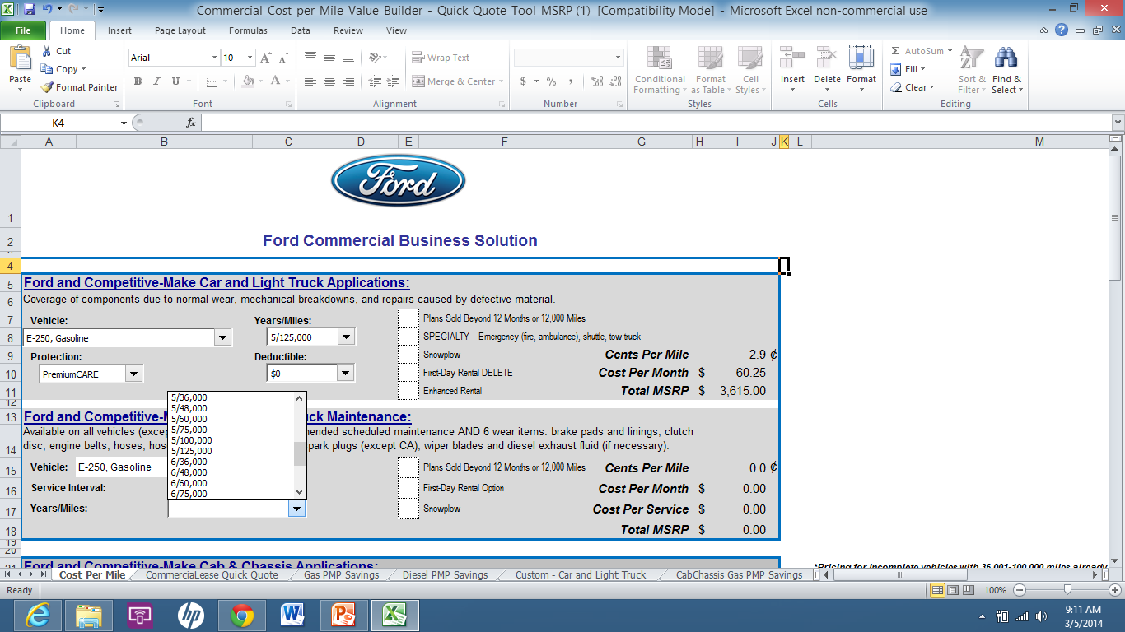
Step 2: Prepare for the Sales Call
Commercial Cost-Per-Mile Value Builder Quick Quote Tool
In Ford and Competitive Make Car and Light Truck Maintenance section:
In Years/Miles field, click on the correct selection from the drop-down menu. When you’ve made the correct choice, click next to advance.
5/60,000
5/75,000
5/100,000
5/125,000
6/36,000
6/48,000
Transit, Gasoline
Notes:
NOTE that not all of the selections that are on the actual drop-down are listed here as choices – there are too many.

Slide 51
Step 2: Prepare for the Sales Call

Slide 52
Step 2: Prepare for the Sales Call
Premium Maintenance Plan Savings
Total Cost of Maintenance Items
Maintenance Plan MSRP
Customer Savings

Slide 53
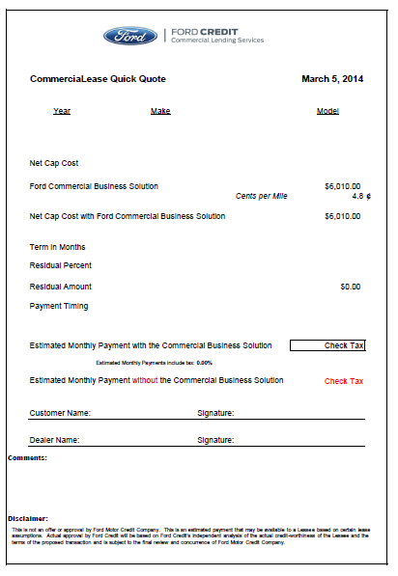
Step 2: Prepare for the Sales Call CommerciaLease Quick Quote
Easily provide a quote on integrating ESP into the monthly lease payment with the CommerciaLease Quick Quote tool.
CommerciaLease Quick Quote
Enter lease information from Ford Credit
Ford Commercial Business Solutions service contract price and cents per mile are imported from Cost-Per-Mile Calculator
Estimated monthly payment with and without Ford Commercial Business Solutions is calculated
Click on the Lee’s Leasing Lesson icon for a demonstration.
Lee’s Leasing Lesson

Slide 54
Step 2: Prepare for the Sales Call CommerciaLease Quick Quote
Lee’s Leasing Lesson

Slide 55
The Sales Approach

Slide 56

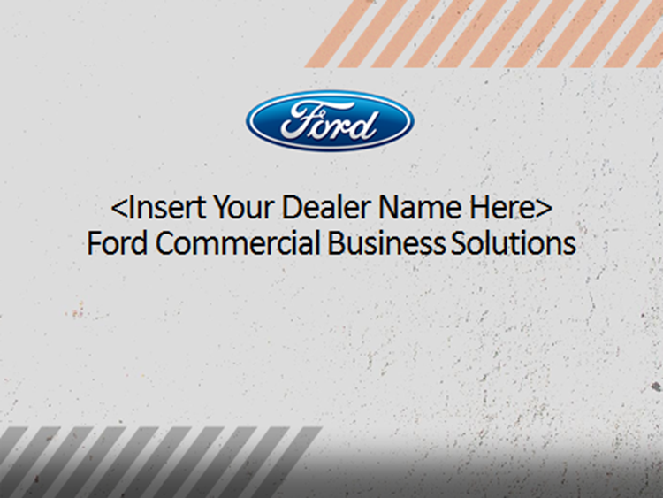
Step 3: Present the Proposal Customer Sales Presentation Template
Now that you and Michelle understand your customer’s requirements, you can develop a targeted Ford Commercial Business Solution presentation. You’ll use a PowerPoint template you can customize with your dealership’s and customer’s information. Let’s watch as Michelle executes these steps.
Download from: FMCDealer.com > Parts & Service tab > ESP link > Fleet link
Click on template cover to learn more.

Slide 57
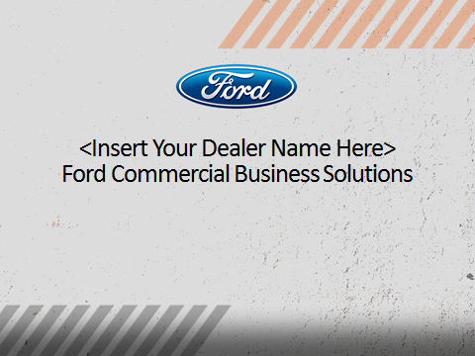
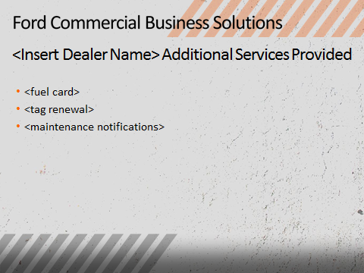
Step 3: Present the Proposal Customer Sales Presentation Template
Michelle begins customizing the presentation template by entering dealership information on the appropriate slides
She also customizes the Dealership Provided Services slide to list additional services her dealership offers commercial customers as part of a Ford Commercial Business Solution.
Click next to see how these 2 pages look once customized

Slide 58
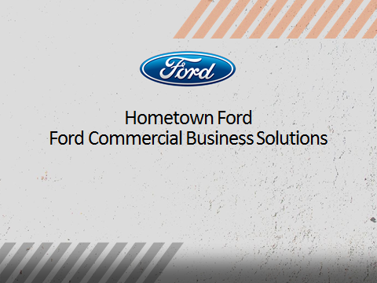
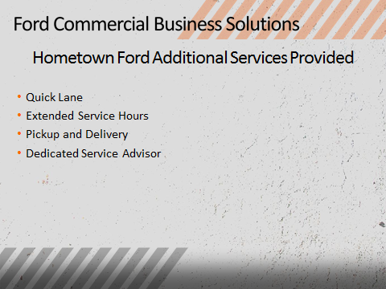
Step 3: Present the Proposal Customer Sales Presentation Template
Customized with Dealership name
and Additional Services

Slide 59
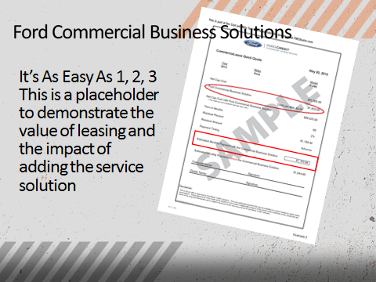
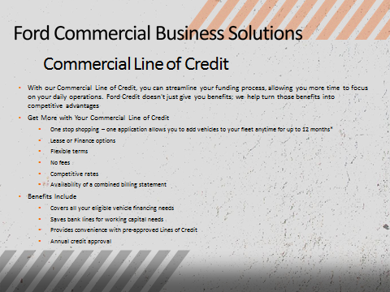
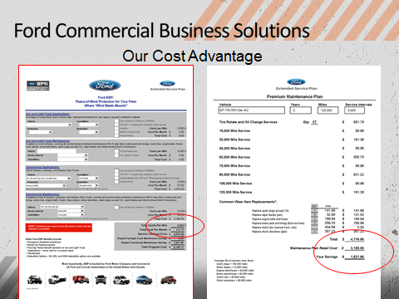
Step 3: Present the Proposal Customer Sales Presentation Template
Michelle adds additional relevant customer information to the template.
For her lease customers, Michelle inserts the CommerciaLease Quick Quote she calculated into the presentation. For customers who are not leasing, she simply deletes this page.
In the Ford Credit section, Michelle keeps the slide for the financing she is recommending and deletes the other slides.
Then, Michelle adds the cost-per-mile and Premium Maintenance savings worksheets to the proposal.
Click next to continue

Slide 60
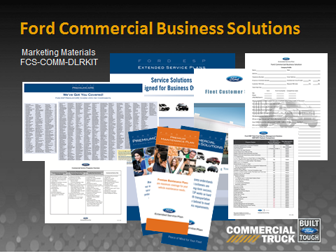
Step 3: Present the Proposal Presentation Materials
Michelle assembles the Customer Sales Presentation Kit in the Commercial Vehicle Presentation folder and adds a QFC credit application, relevant presentation materials and brochures, and the completed worksheets from the Commercial Cost-Per-Mile Value Builder Quick Quote Tool .
Click “Next” to continue.

Slide 61

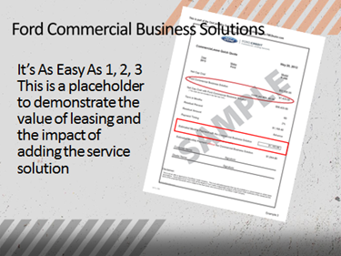

Step 3: Present the Proposal
Present proposal
Reinforce features and benefits
Emphasize cost and time efficiencies
Overcome objections
Ask for the sale

Slide 62
The Sales Approach

Slide 63
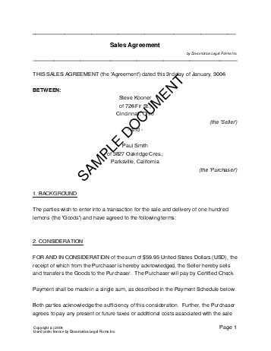
Step 4: Close the Sale
Complete necessary paperwork
ESP application
QFC enrollment and credit application
Thank the customer for his/her business
ESP Service contract app
QFC Enrollment & Credit app
Step 5: Maintain the Relationship
Follow up regularly to ensure customer satisfaction and to respond quickly to any concerns
Wiegand’s
Wisdom

Slide 64
Module Summary
Wiegand’s
Wisdom

Slide 65
Module 4: Resources and Tools

Slide 66
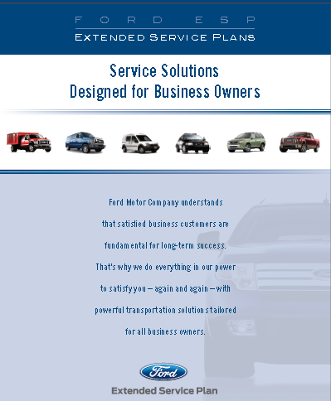
Customer Sales Presentation – Brochures and Flyers
Commercial Vehicle Dealer Kit
Competitive comparison chart
Ford Commercial Service Programs comparison
Fleet Customer Support brochure
Additional Brochures
ESP
Quality Fleet Care
Ford Credit commercial financing options
More!
Available in quantity and
free at the Ford Dealer eStore
FCS-COMM-DLRKIT

Slide 67

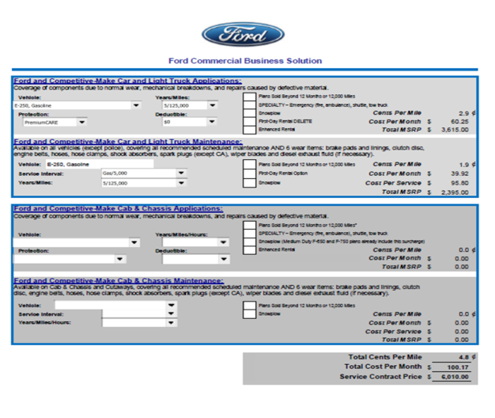
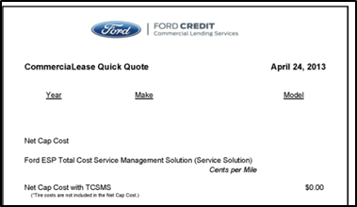
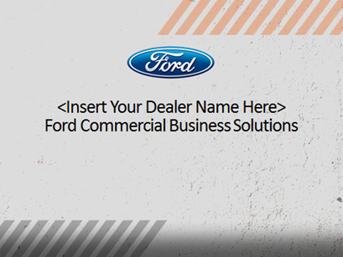
Customer Sales Presentation – Worksheets and Customizable Materials
Customer Interview form
Commercial Cost-Per-Mile Value Builder Quick Quote Tool
CommerciaLease Quick Quote
Customer Presentation template
Download from: FMCDealer.com > Parts & Service tab > ESP link > Fleet link

Slide 68
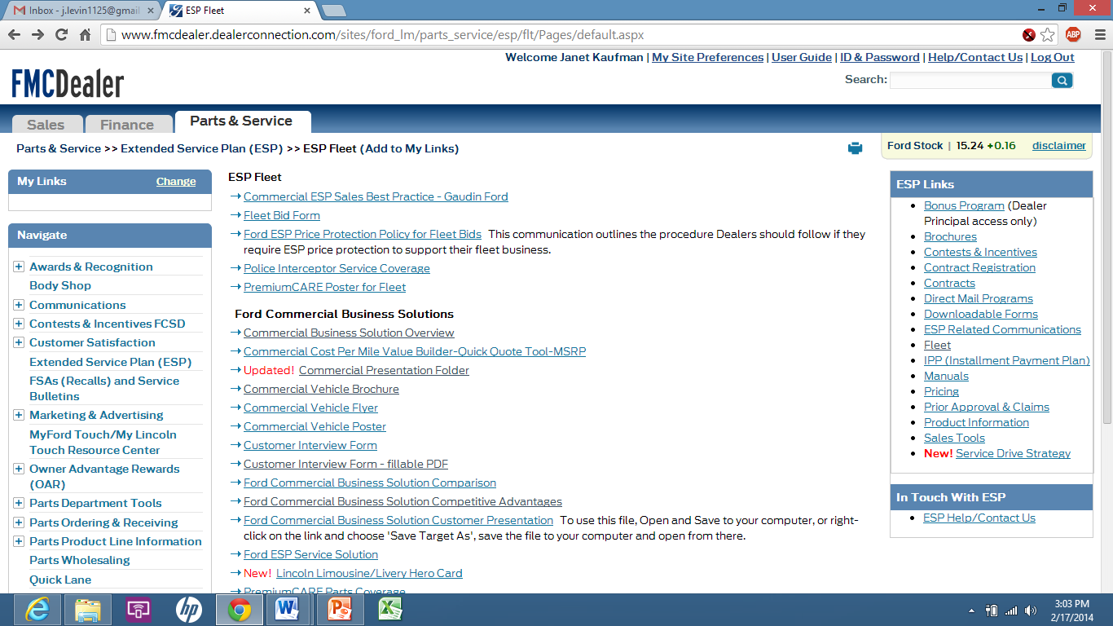
Tools and Resources
FMCDealer.com >Parts & Service>ESP>Fleet
www.qfc.ford.com

Slide 69
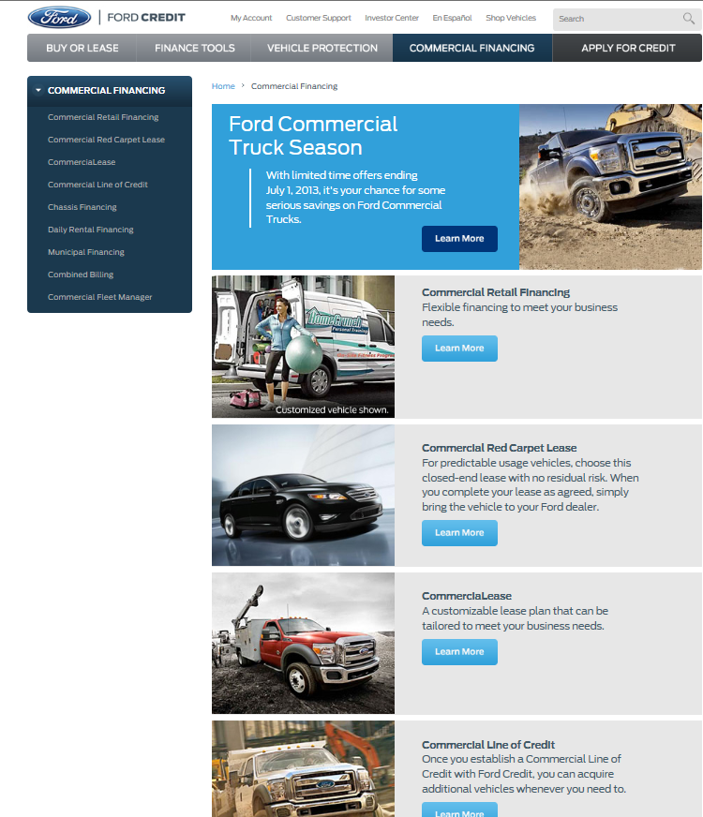
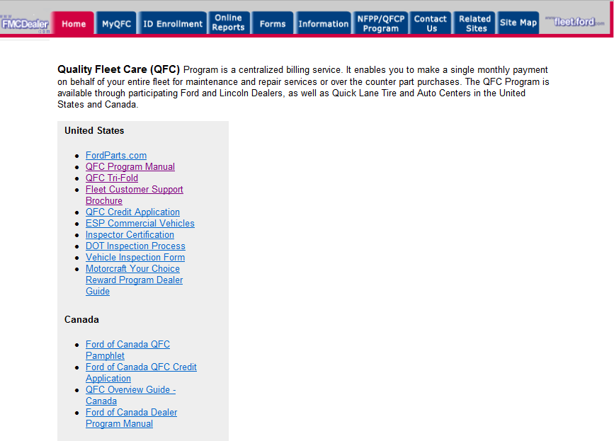
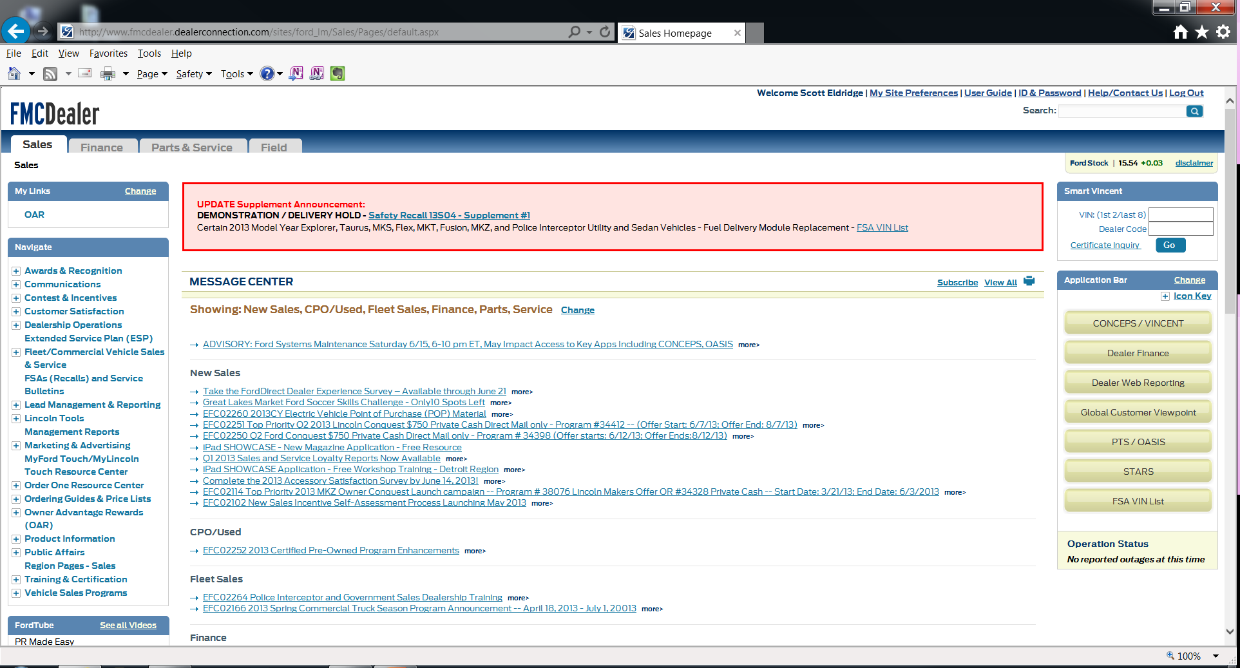
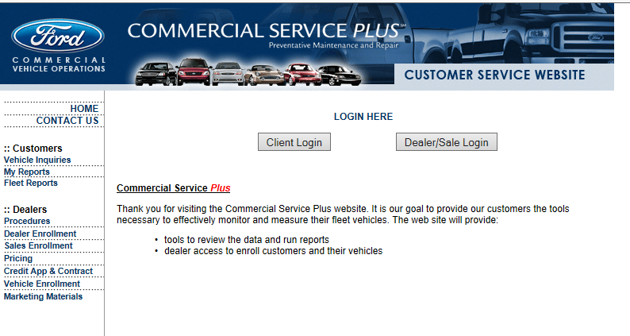
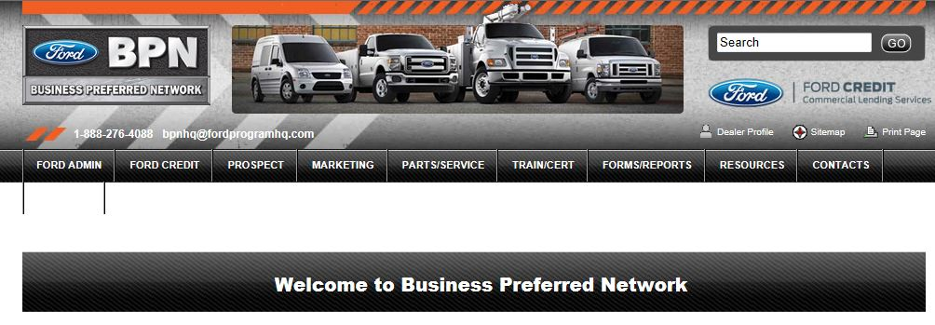
Websites
POSSIBLE DELETE CSP URL
ESP – FMCDealer.com [ESP link, left menu]
QFC – www.qfc.ford.com
CSP – fordcsp.com
Ford Credit Commercial Lending – www.fordcredit.com
BPN - bpn.dealerconnection.com/

Slide 70
Course Summary

Slide 71
Key Learning Points
You have an excellent opportunity to retain, recapture, and grow your commercial business
Ford Commercial Business Solutions is a comprehensive vehicle protection strategy that can be customized to your commercial customers’ individual needs. Its benefits include:
An integrated service strategy
Reduced life-cycle costs
Improved operational efficiencies
Elimination of service variability
Use the available tools and resources to develop customized presentations that will increase your commercial business

Slide 72
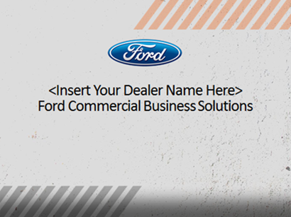
Course Close
Congratulations! You have completed the Growing Your Commercial Business with Ford Commercial Business Solutions web-based training course. You should now be able to:
Explain the opportunity offered by Ford Commercial Business Solutions for increasing dealership commercial business and profitability
Identify commercial customer needs and wants for fleet management services
Demonstrate the benefits and value of Ford Commercial Business Solutions over the competition
Develop customized customer presentations to sell Ford Commercial Business Solutions
Apply a consultative sales process to successfully sell Ford Commercial Business Solutions
Click “Exit” to close this course.

